Slide 1

Placer.ai
Stop & Shop Visits Trend

Slide 2
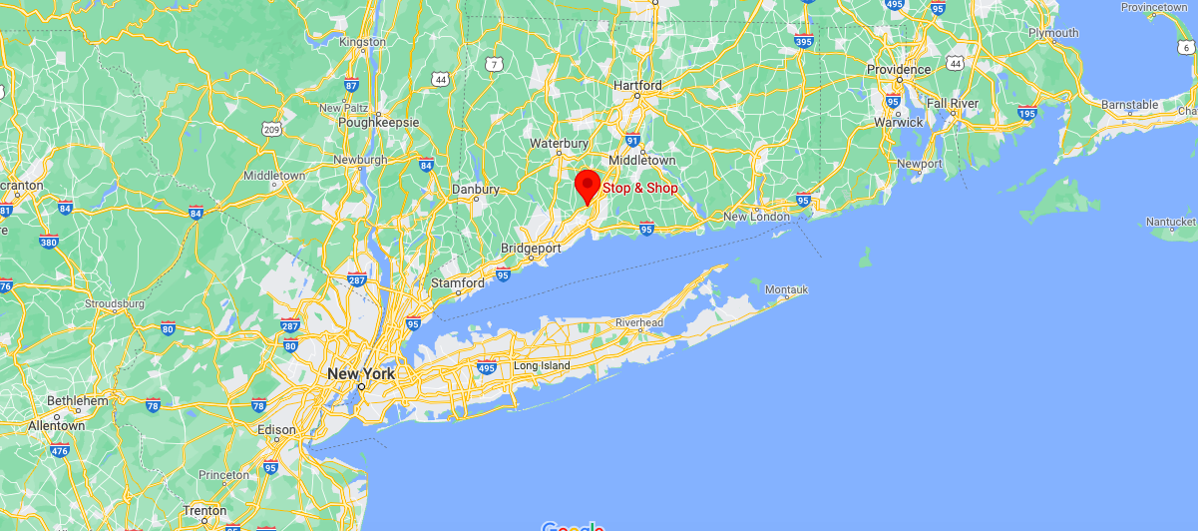
Stop & Shop’s location

Slide 3
Goal of Stop & Shop analysis
We are going to observe the visitation patterns that the store had during the period March 1st, 2019 - August 31st, 2019.
We will analyze who are its customers and what useful information can we take from them.

Slide 4
Active users vs not active users
We have a total of 2589 devices:
1928 of them were active for more than 90 days during the entire period;
661 of them were not active for more than 90 days during the entire period.
For the analysis, we will only care about the active users.

Slide 5
Visitation Patterns
Number of customers at the shop on a weekday vs on the weekend

Slide 6
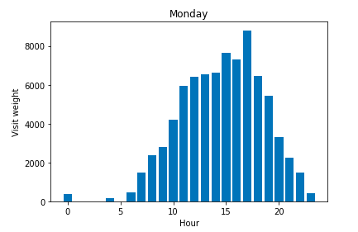
During a weekday

Slide 7
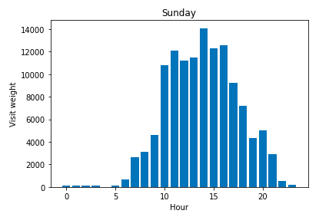
During the weekend

Slide 8
Visitation Patterns
On weekends we can see a much higher influx in the store than on weekdays.

Slide 9
Visitation Patterns
F
Visit weight according to customers’ distance

Slide 10
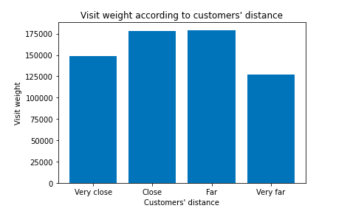

Slide 11
Visitation Patterns
We see that the customers with the highest visit weight are the ones
that are not very close nor very far from the shop
(meaning: between 2 and 7 km away).

Slide 12
Visitation Patterns
F
V
Who are the customers with the greatest visit weight?

Slide 13
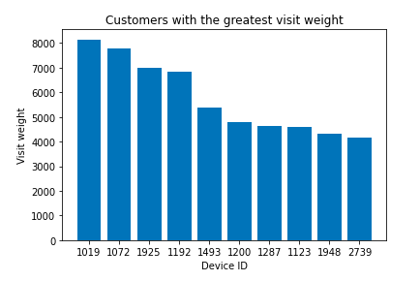

Slide 14
Loyal customers
F
Who are the loyal customers of Stop and Shop?
Out of the 1928 customers that we have been analyzing:
581 are loyal customers
1347 are casual customers

Slide 15
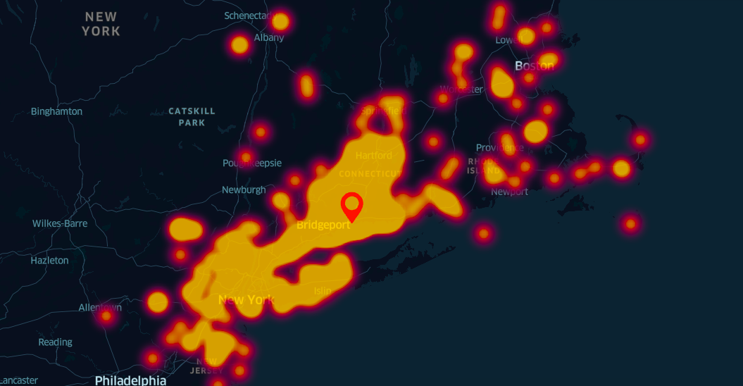
Heatmap of customers’ home location

Slide 16
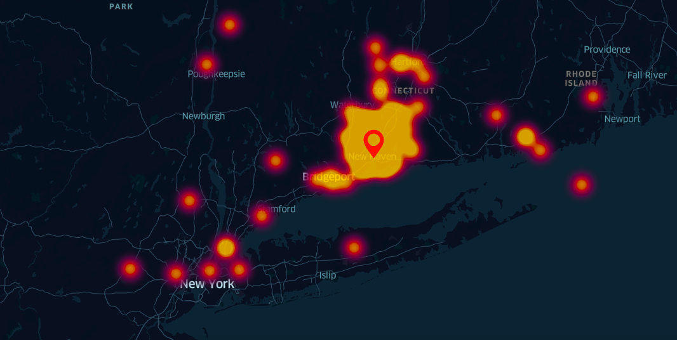
Heatmap of loyal customers’ home location

Slide 17
Loyal customers
F
V
We can observe that the store’s loyal customers are much more concentrated around it

Slide 18
Thank you for viewing this presentation

